Slide 1
Analytics for Audit
Section 1 – Collect - Basic

Slide 2

Sourcing
Excel
Text Files
Flat files
Reports
Text
PDFs
Databases
Access
ODBC

Slide 3
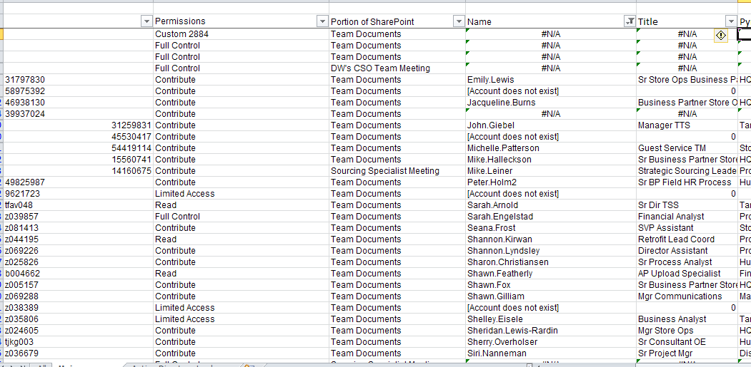
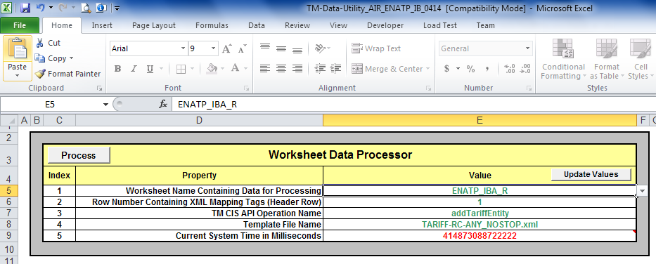

Slide 4
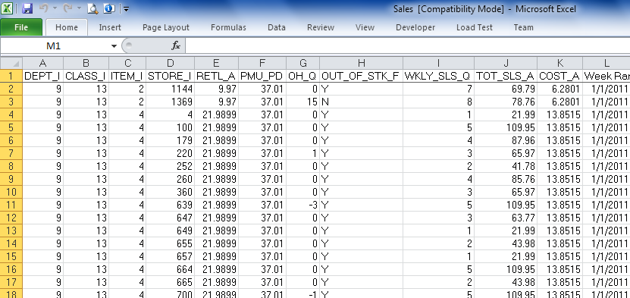
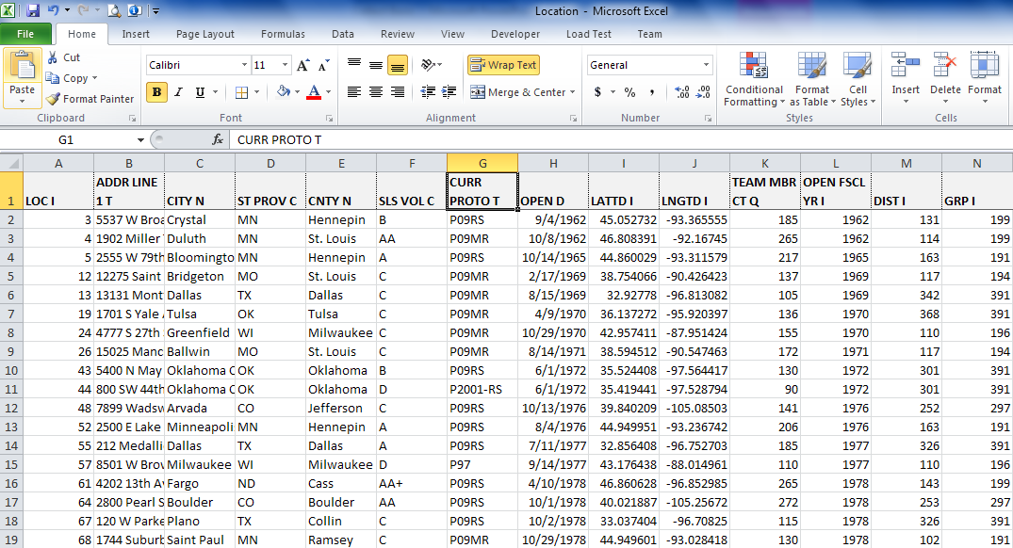
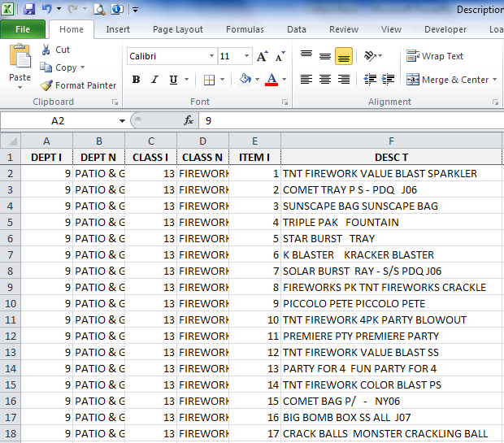


Slide 5
Outline
Objectives
Content
Activity

Slide 6
Content
Import the Sales Spreadsheet

Slide 7
Content
Import the Location Spreadsheet

Slide 8
Quiz
What is the DPCI for the very first sales item?
What is the name of the third store in the location table?
What is the item number of the tenth item in the item table?

